Slide 1
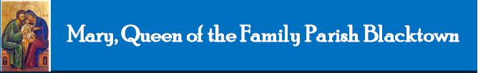
Mary, Queen of the Family Parish
is a welcoming, diverse, multicultural, Catholic community.
We seek to live, teach and share the joy of the Gospel;
to grow as disciples of Jesus through prayer, witness and action
and to respond to the needs of the family in the Blacktown community and beyond.
Notes:
Saturday 5.30PM First Sunday of Advent
16th Sunday in Ord Time Year B

Slide 2
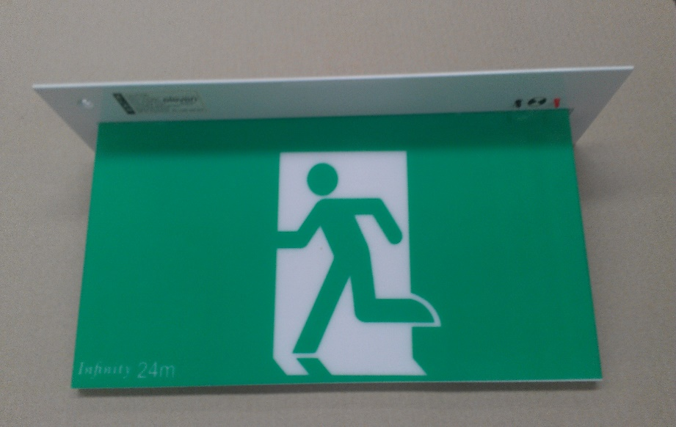
SAFETY MESSAGE
Please take a moment to
identify your closest exit.
There will be an announcement if we need to evacuate the building.
Evacuate the building via the nearest Exit & proceed directly to the footpath along Orwell Street.
DO NOT move any vehicles or remain in the car park.

Slide 3
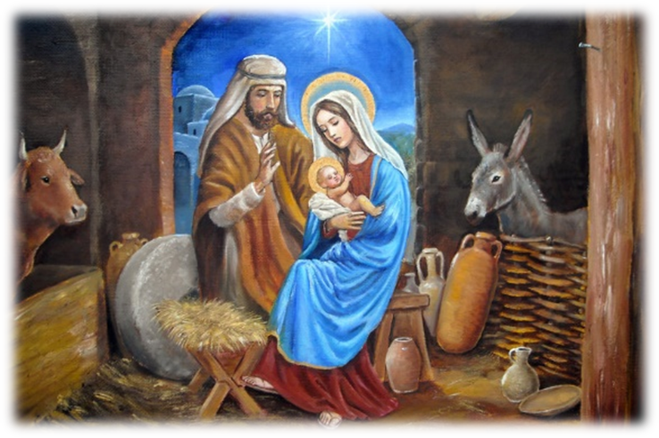
Welcome to our Parish …
Christmas
2015
You have entered a SACRED SPACE ... A SACRED TIME…
Please ensure all mobile phones are switched off.
Please be respectfully quiet as we prepare for our Celebration.
Notes:
Saturday 5.30PM First Sunday of Advent
16th Sunday in Ord Time Year B

Slide 4
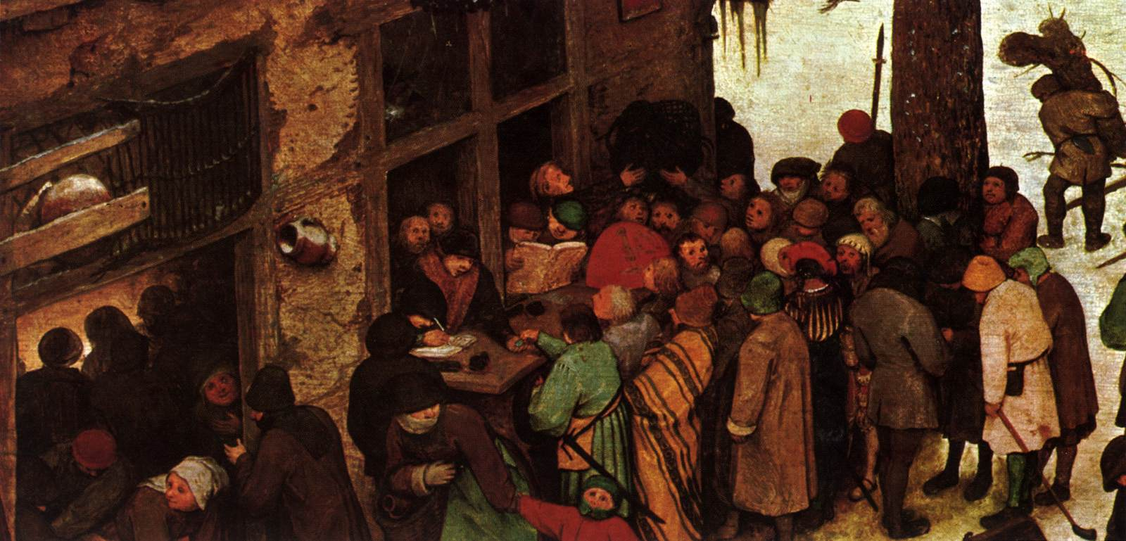
Caesar Augustus issued a decree for a census of the whole world to be taken…
Notes:
16th Sunday in Ord Time Year B

Slide 5
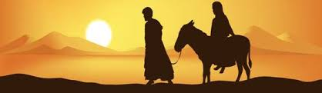
…So Joseph set out from the town of Nazareth in Galilee and travelled up to Judaea, to the town of David called Bethlehem.
Notes:
16th Sunday in Ord Time Year B

Slide 6
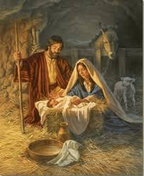
While they were there the time came for her to have her child, and she gave birth to a son, her first-born.
Notes:
16th Sunday in Ord Time Year B

Slide 7
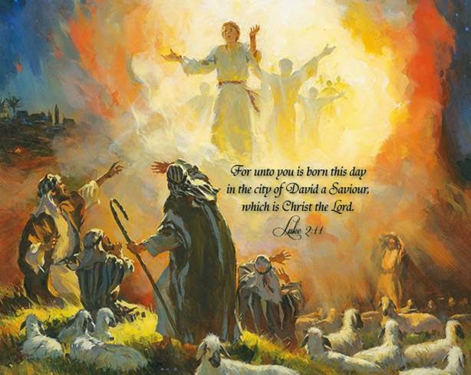
How will I share the joy of the Birth
of our Saviour?

Slide 8
PLEASE STAND

Slide 9
ENTRANCE ANTIPHON
Let us all rejoice in the Lord, for our Saviour has been born in the world.
Today true peace has come down to us from heaven.
The English translation of The Roman Missal © 2010,
International Commission on English in the Liturgy Corporation. All rights reserved.

Slide 11
Penitential Act
Lord have mercy. Lord have mercy.
Christ have mercy. Christ have mercy.
Lord have mercy. Lord have mercy.
The English translation of The Roman Missal © 2010,
International Commission on English in the Liturgy Corporation. All rights reserved.

Slide 13
GLORIA
Glory to God in the highest,
and on earth peace to people of good will.
We praise you, we bless you,
we adore you, we glorify you,
we give you thanks for your great glory,
Lord God, heavenly King,
O God, almighty Father.

Slide 14
Lord Jesus Christ, Only Begotten Son,
Lord God, Lamb of God, Son of the Father,
you take away the sins of the world,
have mercy on us;
you take away the sins of the world,
receive our prayer;
you are seated at the right hand of the Father, have mercy on us.

Slide 15
For you alone are the Holy One,
you alone are the Lord,
you alone are the Most High, Jesus Christ, with the Holy Spirit,
in the glory of God the Father.
Amen.
The English translation of The Roman Missal © 2010,
International Commission on English in the Liturgy Corporation. All rights reserved.

Slide 17

Responsorial Psalm
Today is born our Saviour,
Christ the Lord.

Slide 18
O sing a new song to the Lord,
sing to the Lord all the earth.
O sing to the Lord, bless his name.
Today is born our Saviour,
Christ the Lord.

Slide 19
Proclaim his help day by day,
tell among the nations his glory
and his wonders among all the peoples.
Today is born our Saviour,
Christ the Lord.

Slide 20
Let the heavens rejoice and earth be glad,
let the sea and all within it thunder praise,
let the land and all it bears rejoice,
all the trees of the wood shout for joy
at the presence of the Lord for he comes,
he comes to rule the earth.
Today is born our Saviour,
Christ the Lord.

Slide 21
With justice he will rule the world,
he will judge the peoples with his truth.
Today is born our Saviour,
Christ the Lord.

Slide 22


Slide 23
Gospel Acclamation
Alleluia, alleluia!
Good News and great joy to all the world:
today is born our Saviour, Christ the Lord.
Alleluia!

Slide 25
APOSTLES’ CREED
I believe in God,
the Father almighty,
Creator of heaven and earth,
and in Jesus Christ, his only Son, our Lord,
(At the words that follow, up to and including the Virgin Mary, all bow.)
who was conceived by the Holy Spirit,
born of the Virgin Mary,
suffered under Pontius Pilate,
was crucified, died and was buried;
he descended into hell;

Slide 26
on the third day he rose again from the dead;
he ascended into heaven,
and is seated at the right hand
of God the Father almighty;
from there he will come to judge
the living and the dead.
I believe in the Holy Spirit,
the holy catholic Church,
the communion of saints,
the forgiveness of sins,
the resurrection of the body,
and life everlasting. Amen.

Slide 28
First Collection
This collection goes to the Bishop
for the support of the Diocese.
Thank you for your contribution

Slide 30
Holy, Holy, Holy
Holy, Holy, Holy Lord God of hosts,
Heaven and earth are full of your glory.
Hosanna in the highest
Blessed is he who comes
in the name of Lord,
Hosanna in the highest.
The English translation of The Roman Missal © 2010,
International Commission on English in the Liturgy Corporation. All rights reserved.

Slide 32
Save us, Saviour of the world,
for by your Cross
and Resurrection
you have set us free.
Memorial Acclamation
We proclaim your Death, O Lord,
and profess your Resurrection
until you come again.
When we eat this Bread and drink this Cup, we proclaim your Death,
O Lord, until you come again.
The English translation of The Roman Missal © 2010,
International Commission on English in the Liturgy Corporation. All rights reserved.
Notes:
Sunday 10AM First Sunday of Advent
7am - 14th Sunday in Ord Time
16th Sunday in Ord Time Year B

Slide 34
Amen
When we eat this Bread and drink this Cup, we proclaim your Death,
O Lord, until you come again.
Amen
We proclaim your Death, O Lord,
and profess your Resurrection
until you come again.
The English translation of The Roman Missal © 2010,
International Commission on English in the Liturgy Corporation. All rights reserved.
Notes:
Sunday 10AM First Sunday of Advent
7am - 14th Sunday in Ord Time
16th Sunday in Ord Time Year B

Slide 36
Lamb of God
Lamb of God, you take away the sins of the world, have mercy on us.
Lamb of God, you take away the sins of the world, have mercy on us.
Lamb of God, you take away the sins of the world, grant us peace.
The English translation of The Roman Missal © 2010,
International Commission on English in the Liturgy Corporation. All rights reserved.

Slide 38
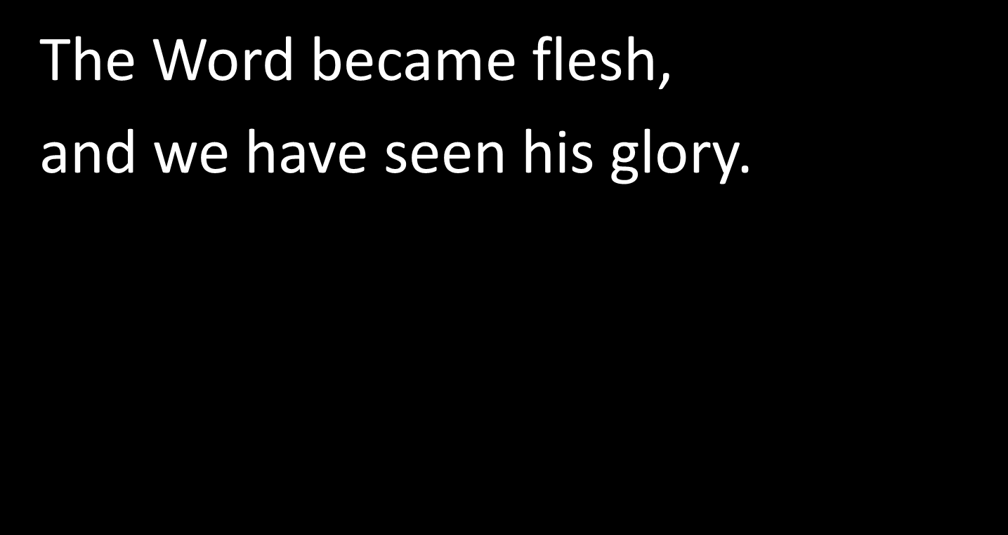
COMMUNION ANTIPHON
The English translation of The Roman Missal © 2010,
International Commission on English in the Liturgy Corporation. All rights reserved.

Slide 40
Second Collection
What you contribute now
is for the support of our
parish and its mission.
Thank you for your generosity

Slide 41
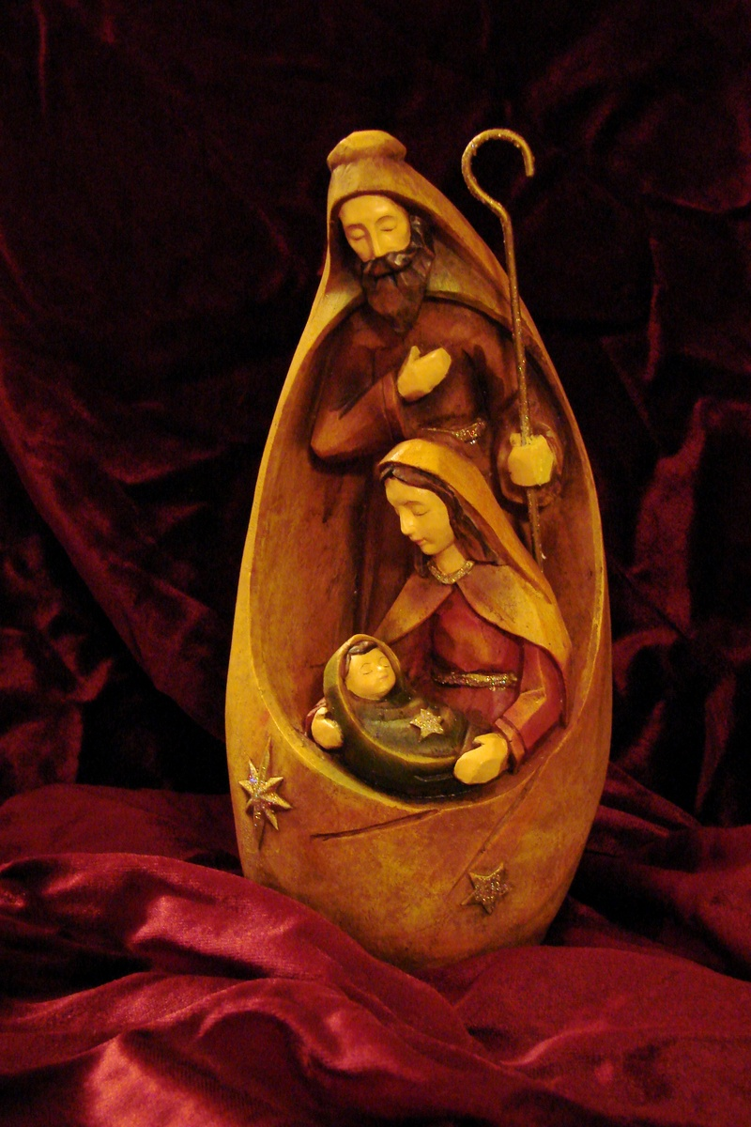
Wishing you a happy and holy Christmas.

Slide 42
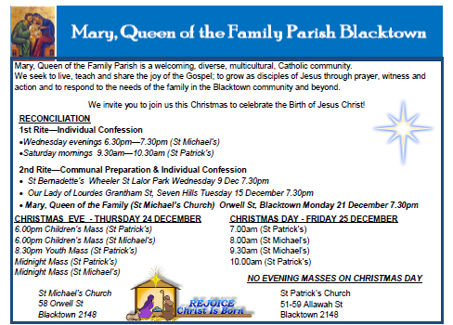



www.mqofblacktown.org.au
    www.facebook.com/blacktowncatholics
@mqofblacktown

Slide 44
How will I share the joy of the Birth
of our Saviour?

